Slide 1
Welcome to Uplands Junior Academy
An introduction to us and our school.
School priorities
Attendance, reading
Uniform
Behaviour
How we communicate with parents – newsletter every Friday, website, twitter.
FSM and PPG

Slide 2
Safeguarding
Mrs Carlisle -Designated Safeguarding Lead
Mr Buckley– Deputy Safeguarding Lead
Mr Deacon-Deputy Safeguarding Lead
Mrs Patel –Deputy Safeguarding Lead
Mrs Shaukat-Deputy Safeguarding Lead
Mr Walker - Deputy Safeguarding Lead
Josh Wills – Chair of Governors
Policies – anti bullying, behaviour , safeguarding

Slide 3
Y3 – Miss Ayres (Y3 lead and writing lead)
Y3 curriculum overview – LTP
Transition day for the year 2 children
Handover from Y2 team.
Uniform to be labelled with the children’s name and class.
Twitter
Phonic revision lessons and intervention groups
What you can do to give your child a flying start into Y3

Slide 4
Writing and Spelling
We use a novel-based approach so each year group studies 3 books a year to inspire their writing in their English lessons.
The children will learn about many text types (explanation text, recount, instructions etc.) and every 2 weeks they will write one of these texts types using the book/topic as inspiration. Where possible, we will write to people/organisations. (Twitter too)
We use Alan Peat’s Exciting Sentences approach to introduce the children to various and exciting sentence structures.
‘No Nonsense spelling’ is the spelling scheme. It teaches spelling rules and patterns in a visual and cohesive way. Spelling Shed (online platform) will still be used so children can play games to learn their spellings set that week. The more the children play on Spelling Shed, the more money they can earn in our celebration assemblies. There is now an area to play grammar games too.

Slide 5
Maths – Mr Buckley
Power Maths is used to provide the structure to our curriculum. It is sequenced so that children can build their knowledge in number and place value before applying it across other strands of maths such as statistics, geometry and measurement.
We start to encourage children to present their work more carefully in Year 3, so children will record a lot of their maths work in an exercise book.

Slide 6
Quick recall of times tables

Slide 7
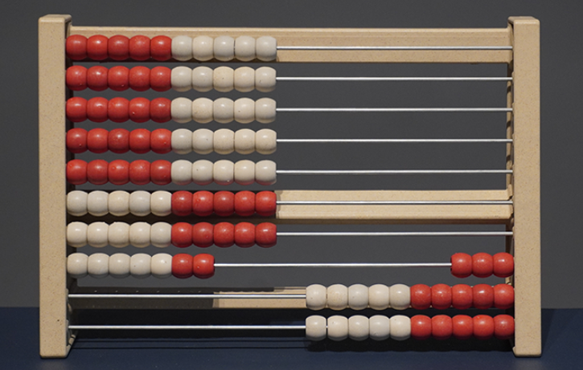
Rekenrek (counting rack)
This gives children a strong visual representation of multiplication as repeated addition.

Slide 8
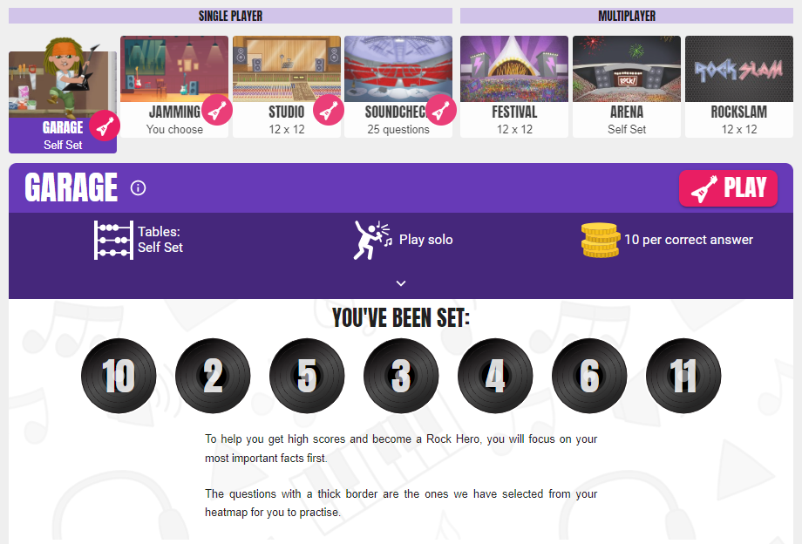
Times Tables Rock Stars (TTRS)
Your child will have access to Times Tables Rock Stars (TTRS) – a game-based online learning platform to assist pupils in hard-wiring the multiplication number facts.
10 minutes of practice at home every day can make a huge difference.

Slide 9
Accelerated Reader
Library
MyOn
Reading at Uplands Junior L.E.A.D Academy
by Mr Deacon
Prizes
Teaching of Reading
Whole Class Reading

Slide 10
What we do to support your child in school:
ALS phonics currently for all children who have not yet passed their phonics screening
1:1 daily reading for some children
All children will read independently
Class novel based curriculum and teacher led reading
Reading Rocketeers for interventions
Language for thinking for those who struggle with language
Flash Academy for those new to English
A library filled with 1000s of age appropriate and modern books.

Slide 11
The power of reading for academic achievement
Based on reading skills data for 712 pupils aged 11 to 14, young people who read daily in their free time are twice as likely to read above the level expected for their age than children who don’t read daily (37.6% vs 14.2%) (National Literacy Trust)
Results from the world’s largest annual study of student reading habits found that students who started the year as struggling readers but ended the year at or above benchmark each day read just six more minutes than struggling readers who did not meet benchmark.
An analysis of more than 9.9 million students found that only those students who read 15 minutes or more per day made accelerated reading gains.
Some researchers estimate that children learn 1 new word for every 1,000 words read.

Slide 12
Accelerated Reader
All year groups to follow AR
Use of iPads and tablets in each classroom to complete quizzes on a daily basis.
Each teacher will monitor quizzes and scores, if they are consistently scoring high then look to move up ZPD and equally the other way.
Word count is kept as a competition and we give book prizes to children each term.
MyOn
Full access on any mobile or computer device
Over a 1000 books to choose from online.
They can choose to read alone or have the computer read it.
After every book, children can take a quiz.
Some books will be directed to the children as they are at their age relation.

Slide 13
Reading continued
Children will be given 15 - 20mins of independent reading (inclusive of exchanging books &/or quizzing).
Teachers may recommend books for children to read. Share through news bulletin and display a book of the month and what we are reading at the moment.
100 books all children in year 3,4,5 and 6 to be shared with the children.

Slide 14
Mrs Shaukat- SENCO
Here to support your child should they have any barriers to their learning or Special Educational Needs or Disabilities.
SENCO role: support, monitor and celebrate. Overview across the school for your child.
If you have concerns about your child’s rate of progress or wellbeing?
Early monitoring process
Graduated response – Assess, Plan, Do, Review
Learning plans – Provision Map
SEND coffee mornings/workshops
Family centered approach
Best Endeavours and Reasonable Adjustments

