Slide 1


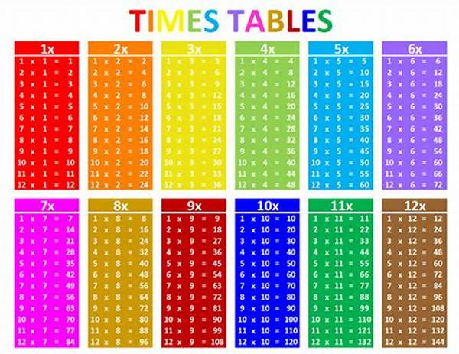
Multiplication Tables Check 2024-2025

Slide 2
The Department for Education have said that the Multiplication Tables Check is:
An online assessment
It has been designed to determine whether pupils can fluently recall their multiplication tables up to their 12 times table
It will allow the school to support children who do not yet have the recall of their multiplication tables
There is an expectation in the National Curriculum that:
Year 3 can, “Recall and use multiplication and division facts for the 3, 4 and 8 multiplication tables.”
Year 4 can, “Recall multiplication and division facts for multiplication tables up to 12 × 12.”

Slide 3
Why is the Multiplication Tables Check being introduced?
Multiplication facts underpin a lot of maths knowledge:
Division
Fractions
Percentages
Multiplication
Number sequences
Many more!
All these areas when linked to problem solving
Expectations (x and ÷) from Y1 – 4 in the National Curriculum

Slide 4
What will the Multiplication Tables Check look like?
The check will take place in June and we will notify you of when this will be nearer the time.
3 practise questions and 25 test questions
6 seconds per question followed by a 3 second break
Questions will be generated randomly and commutative questions will not appear e.g. if you are asked 7 x 9 you will not get 9 x 7 too.
There is no pass mark – the DFE will report the number of children who achieve 25 out of 25.

Slide 5
What are we doing at school to help the children prepare?
‘Soundcheck’ programme on Times Tables Rock Stars every day
Rekenreks-once a week.
Games played during the school day (gamification of learning)
Weekly practise to go home with and set tables to focus on.

Slide 6
What can you do to support your child?
Play games with your child to support their recall of times table facts
Ensure children are constantly revisiting their times table facts from previous weeks to ensure they develop fluency in all facts
Support and encourage your child – ask them questions about their progress on TTRS (you write your answers they play online)
TTRS Battle of the bands

Slide 7
Recommendations from Times Table Rock Stars
Go onto TTRS for 5 minutes a day.

Slide 8
Gamification of Learning
Hit the Button (online) - https://www.topmarks.co.uk/maths-games/hit-the-button
Catch! – children throw a ball to one another and ask a multiplication question as the throw it e.g. call someone’s name then say 3 x 7 = the person whose name was called has to answer the question correctly. If they get it right, they continue the game and call someone else’s name, ask a question and throw the ball.
Beat the Teacher/Beat my adult – who can answer more question in 1 min/30 seconds – keep a tally so you know whether students or the teacher is winning.
Bingo! – children write down 3 or 4 multiples from a given times table e.g. for the 9 times table they might write down 81, 27 and 36 (don’t write too many – small focus e.g. on one or two times tables) teacher or another student calls out the times table question e.g. 3 x 9 and if children have 27, they cross it out. You could also do this in reverse, write down the question and teachers call out the multiples.
Throw the Dice – children work in pairs to throw two dice and call out the answer to the multiplication question show – keep a tally as to who has answered more questions correctly (play for max 2/3 mins)
Kinaesthetic tables – get children jumping, running (relay) or moving in any way they like to recite their tables (including the question e.g. 9 x 6 is 54)
The Disappearing Man – draw a stick person on the board and write a times table inside. Children come to the board and give a fact based on the times table e.g. if 12 is written inside they could say 4 x 12 = 48 this means they can rub out a limb/part of the stick man. If children get a question wrong, the teacher adds a limb/part to their stick man. The children have to rub out their stick man before the teacher completes theirs.

Slide 9
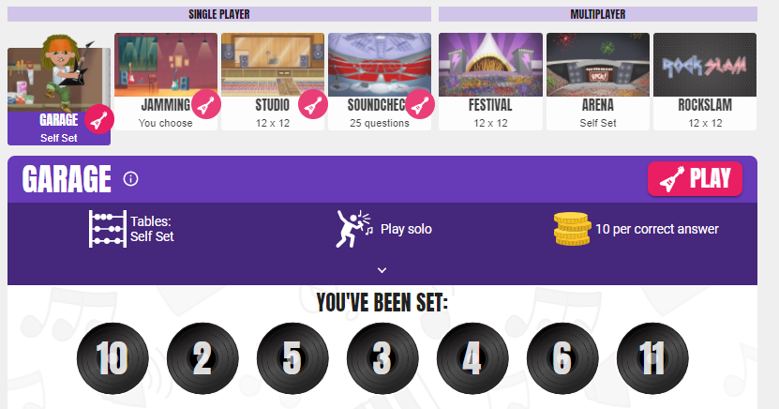
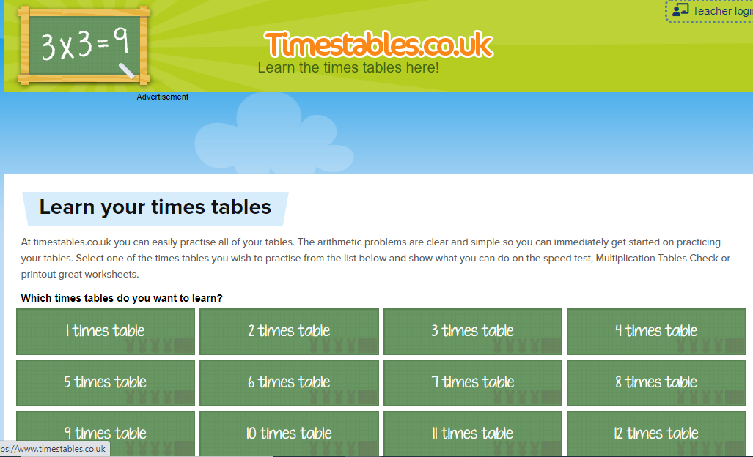
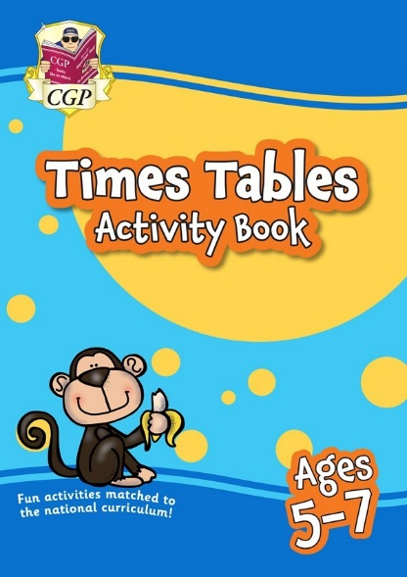
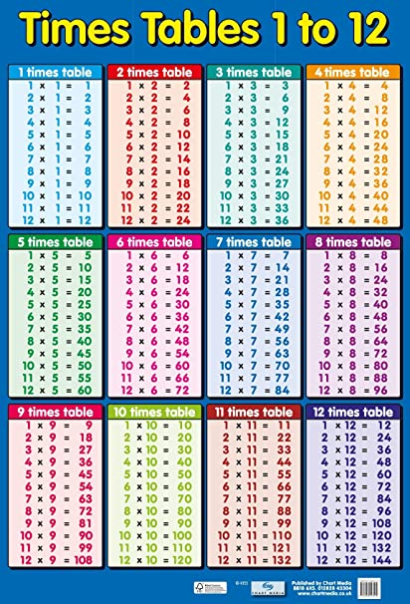
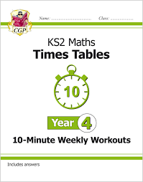
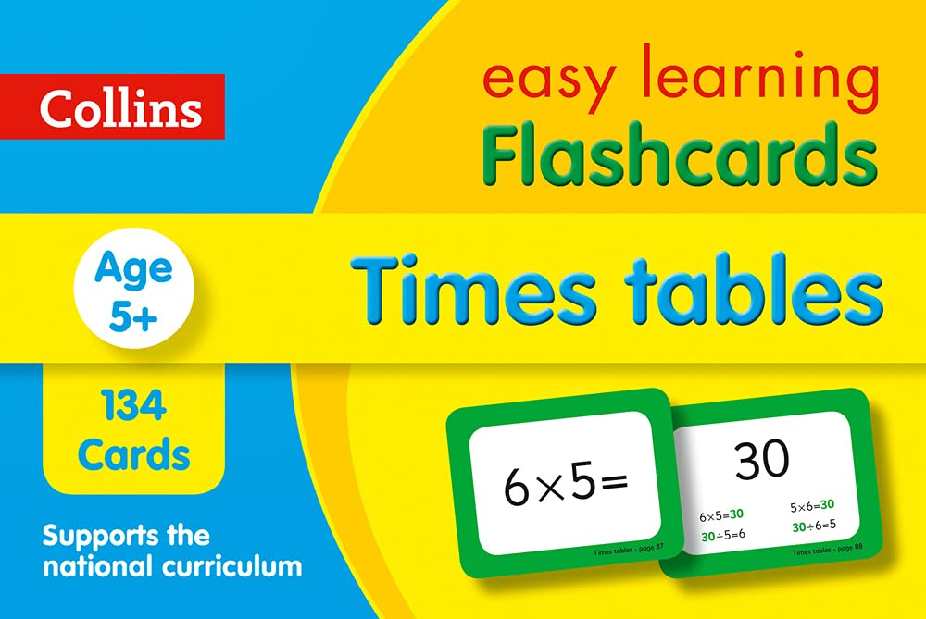

Slide 10
Any Questions?
Take 3
Make practise memorable and fun
Keep it consistent
Keep to the 5 minutes a day.

